Slide 1


E-Commers

Slide 2
TEAM MEAMBERS
SAURABH
DIVESH
SHAMAL
TANMAYA Teja

Slide 3
TEAM MEAMBERS
Overview of the project
SAURABH
DIVESH
SHAMAL
TANMAYA Teja
Data sources
Key Performance Indicators (KPIs)
Tools used (Excel, MySQL, Tableau, PowerBI)
Analysis Steps
Dashboards
Conclusion

Slide 4

Overview of the project
TEAM MEAMBERS
SUMMARY
SAURABH
DIVESH
SHAMAL
TANMAYA Teja
Olist is an intermediary a Brazilian e-commerce platform that streamlines the e-commerce process for sellers and provides a convenient marketplace for buyers. It offers services ranging from product listing to order fulfillment and leverages data to enhance the overall selling experience on its platform.
Data sources
Key Performance Indicators (KPIs)
Tools used (Excel, MySQL, Tableau, PowerBI)
Analysis Steps
Dashboards
Conclusion

Slide 5
Overview of the project
TEAM MEAMBERS
DATA SET DETAILS
SUMMARY
SAURABH
DIVESH
SHAMAL
TANMAYA Teja
DATA SET CONTAINS INFORMATION ABOUT OLIST STORE .
DATA SET HAS TOTAL 9 SHEETS AS FOLLOWS
olist_ order_ items_ dataset
olist_ order_ payments _ dataset
olist_ order_ reviews_ dataset
olist_ orders_ dataset
olist_ products_ dataset
olist_ sellers_ dataset
product_ category_ name_ translation
olist_ customers_ dataset
olist_ geolocation_ dataset
Olist is an intermediary a Brazilian e-commerce platform that streamlines the e-commerce process for sellers and provides a convenient marketplace for buyers. It offers services ranging from product listing to order fulfillment and leverages data to enhance the overall selling experience on its platform.
Data sources
Key Performance Indicators (KPIs)
Tools used (Excel, MySQL, Tableau, PowerBI)
Analysis Steps
Dashboards
Conclusion

Slide 6
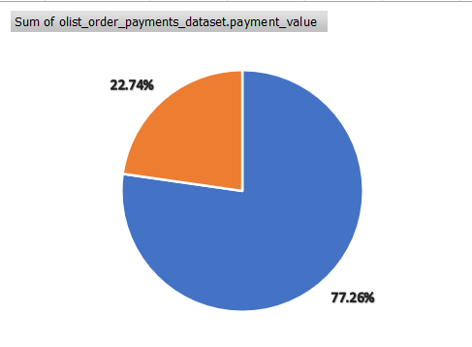
DATA SET DETAILS
Overview of the project
TEAM MEAMBERS
KPI 1 : Weekday Vs Weekend (order_purchase_timestamp)
SUMMARY
SAURABH
DIVESH
SHAMAL
TANMAYA Teja
Olist is an intermediary a Brazilian e-commerce platform that streamlines the e-commerce process for sellers and provides a convenient marketplace for buyers. It offers services ranging from product listing to order fulfillment and leverages data to enhance the overall selling experience on its platform.
Question: What are the differences in order volume between weekdays and weekends, and which promotions have proven to be most effective in balancing staff workload and maximizing sales on weekdays?
Insight: Weekdays have more orders than weekends, so businesses should staff up and offer special promotions during the week
Data sources
Key Performance Indicators (KPIs)
Tools used (Excel, MySQL, Tableau, PowerBI)
Analysis Steps
Dashboards
Conclusion
DATA SET CONTAINS INFORMATION ABOUT OLIST STORE .
DATA SET HAS TOTAL 9 SHEETS AS FOLLOWS
olist_ order_ items_ dataset
olist_ order_ payments _ dataset
olist_ order_ reviews_ dataset
olist_ orders_ dataset
olist_ products_ dataset
olist_ sellers_ dataset
product_ category_ name_ translation
olist_ customers_ dataset
olist_ geolocation_ dataset

Slide 7
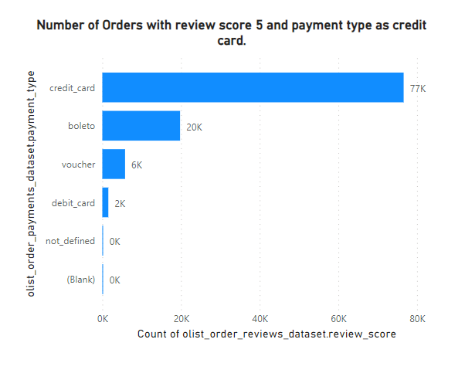
DATA SET DETAILS
KPI 1 : Weekday Vs Weekend (order_purchase_timestamp)
Overview of the project
TEAM MEAMBERS
KPI 2 : Number of Orders with review score 5 and payment type as credit card
SUMMARY
SAURABH
DIVESH
SHAMAL
TANMAYA Teja
Question: How do the number of 5-star reviews compare when payment is made with a credit card versus other payment methods, and which credit card promotions have the strongest positive impact on customer satisfaction?
Insight: Most orders with 5-star reviews were paid for with credit card, so businesses should offer special promotions for credit card payments
Question: What are the differences in order volume between weekdays and weekends, and which promotions have proven to be most effective in balancing staff workload and maximizing sales on weekdays?
Insight: Weekdays have more orders than weekends, so businesses should staff up and offer special promotions during the week
Olist is an intermediary a Brazilian e-commerce platform that streamlines the e-commerce process for sellers and provides a convenient marketplace for buyers. It offers services ranging from product listing to order fulfillment and leverages data to enhance the overall selling experience on its platform.
Data sources
Key Performance Indicators (KPIs)
Tools used (Excel, MySQL, Tableau, PowerBI)
Analysis Steps
Dashboards
Conclusion
DATA SET CONTAINS INFORMATION ABOUT OLIST STORE .
DATA SET HAS TOTAL 9 SHEETS AS FOLLOWS
olist_ order_ items_ dataset
olist_ order_ payments _ dataset
olist_ order_ reviews_ dataset
olist_ orders_ dataset
olist_ products_ dataset
olist_ sellers_ dataset
product_ category_ name_ translation
olist_ customers_ dataset
olist_ geolocation_ dataset

Slide 8
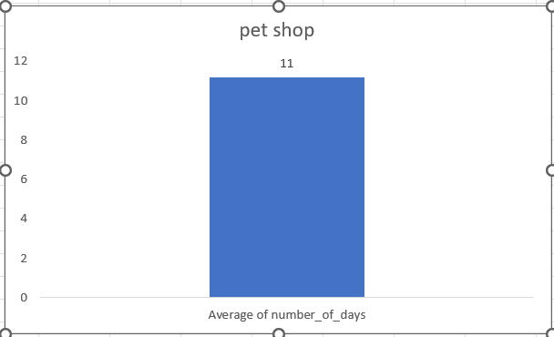
KPI 2 : Number of Orders with review score 5 and payment type as credit card
KPI 3 : Average number of days taken for order_delivered_customer_date for pet_shop.
Question: What is the current average delivery time for pet shop orders, and how does this compare to the delivery time improvements seen when partnering with faster shipping carriers?
Insight: Pet shop orders take longer days to deliver, so businesses should set realistic delivery expectations and partner with faster shipping carriers
Question: How do the number of 5-star reviews compare when payment is made with a credit card versus other payment methods, and which credit card promotions have the strongest positive impact on customer satisfaction?
Insight: Most orders with 5-star reviews were paid for with credit card, so businesses should offer special promotions for credit card payments

Slide 9
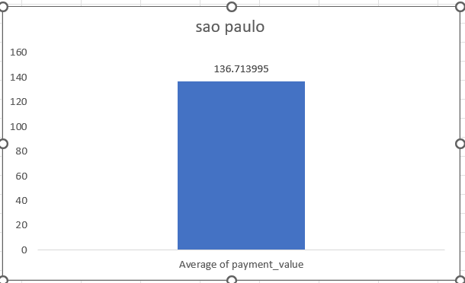
KPI 2 : Number of Orders with review score 5 and payment type as credit card
KPI 3 : Average number of days taken for order_delivered_customer_date for pet_shop.
KPI 4 : Average price and payment values from customers of Sao Paulo city
Question: What are the spending patterns of customers from São Paulo in terms of average order value, and which product categories and discount strategies have led to increased sales in this region?
Insight: São Paulo customers spend money on online orders, so businesses should offer a wider selection of products and services with attractive discounts
Question: What is the current average delivery time for pet shop orders, and how does this compare to the delivery time improvements seen when partnering with faster shipping carriers?
Insight: Pet shop orders take longer days to deliver, so businesses should set realistic delivery expectations and partner with faster shipping carriers
Question: How do the number of 5-star reviews compare when payment is made with a credit card versus other payment methods, and which credit card promotions have the strongest positive impact on customer satisfaction?
Insight: Most orders with 5-star reviews were paid for with credit card, so businesses should offer special promotions for credit card payments

Slide 10
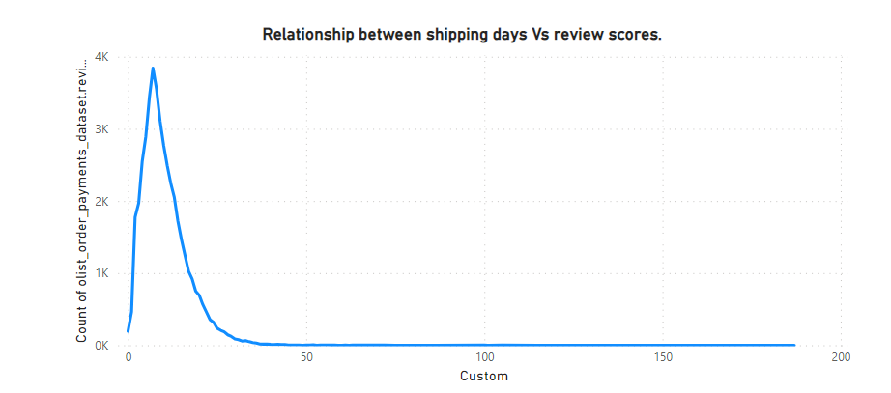
KPI 2 : Number of Orders with review score 5 and payment type as credit card
KPI 3 : Average number of days taken for order_delivered_customer_date for pet_shop.
KPI 5 : Relationship between shipping days (order_delivered_customer_date - order_purchase_timestamp) Vs review scores
KPI 4 : Average price and payment values from customers of Sao Paulo city
Question: How does the length of shipping time correlate with customer review scores, and what improvements in the shipping process can most effectively decrease shipping days and enhance overall customer satisfaction?
Insight: Customers give higher review scores for faster shipping, so businesses should focus on improving their shipping times
Question: What is the current average delivery time for pet shop orders, and how does this compare to the delivery time improvements seen when partnering with faster shipping carriers?
Insight: Pet shop orders take longer days to deliver, so businesses should set realistic delivery expectations and partner with faster shipping carriers
Question: What are the spending patterns of customers from São Paulo in terms of average order value, and which product categories and discount strategies have led to increased sales in this region?
Insight: São Paulo customers spend money on online orders, so businesses should offer a wider selection of products and services with attractive discounts
Question: How do the number of 5-star reviews compare when payment is made with a credit card versus other payment methods, and which credit card promotions have the strongest positive impact on customer satisfaction?
Insight: Most orders with 5-star reviews were paid for with credit card, so businesses should offer special promotions for credit card payments

Slide 11

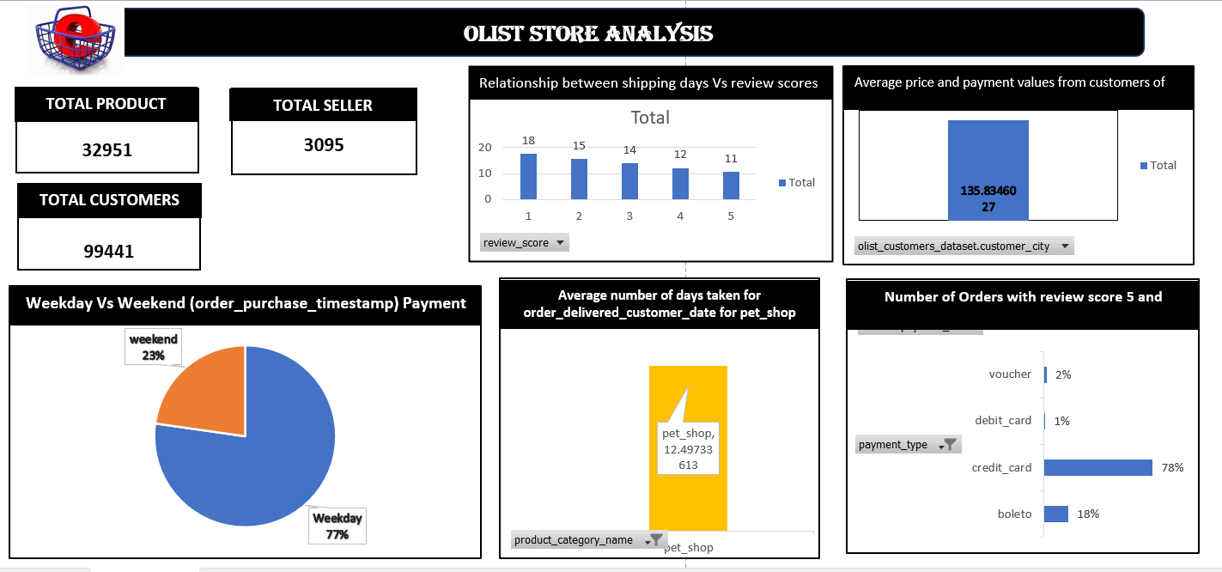
KPI 5 : Relationship between shipping days (order_delivered_customer_date - order_purchase_timestamp) Vs review scores
EXCEL-DASHBORD
KPI 2 : Number of Orders with review score 5 and payment type as credit card
KPI 3 : Average number of days taken for order_delivered_customer_date for pet_shop.
KPI 4 : Average price and payment values from customers of Sao Paulo city
Question: How does the length of shipping time correlate with customer review scores, and what improvements in the shipping process can most effectively decrease shipping days and enhance overall customer satisfaction?
Insight: Customers give higher review scores for faster shipping, so businesses should focus on improving their shipping times

Slide 12

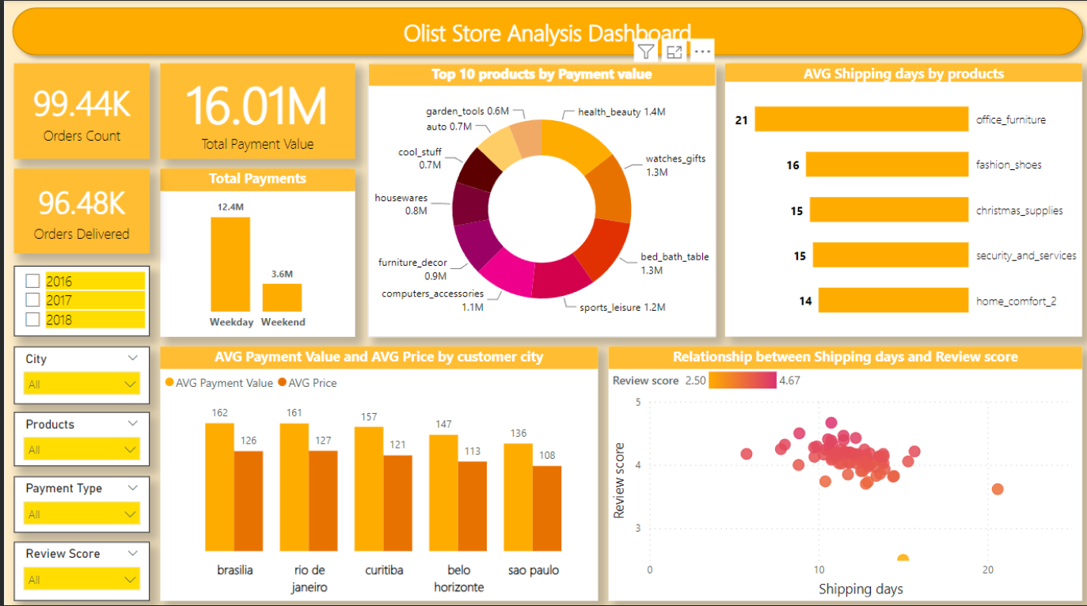
KPI 5 : Relationship between shipping days (order_delivered_customer_date - order_purchase_timestamp) Vs review scores
KPI 2 : Number of Orders with review score 5 and payment type as credit card
KPI 3 : Average number of days taken for order_delivered_customer_date for pet_shop.
KPI 4 : Average price and payment values from customers of Sao Paulo city
Question: How does the length of shipping time correlate with customer review scores, and what improvements in the shipping process can most effectively decrease shipping days and enhance overall customer satisfaction?
Insight: Customers give higher review scores for faster shipping, so businesses should focus on improving their shipping times

Slide 13

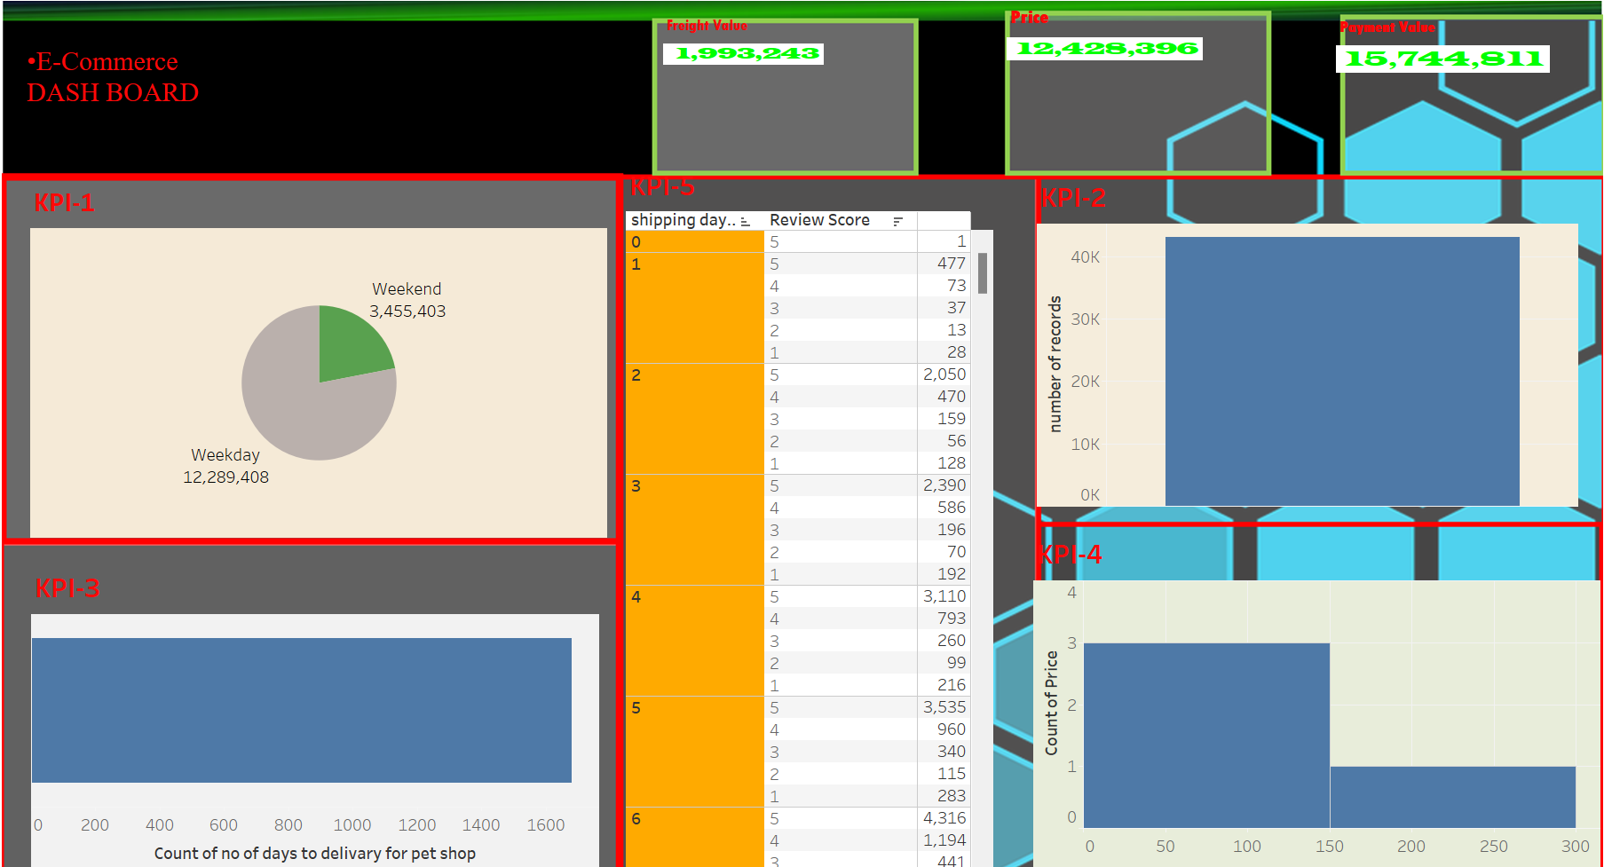
KPI 3 : Average number of days taken for order_delivered_customer_date for pet_shop.
KPI 4 : Average price and payment values from customers of Sao Paulo city
Question: How does the length of shipping time correlate with customer review scores, and what improvements in the shipping process can most effectively decrease shipping days and enhance overall customer satisfaction?
Insight: Customers give higher review scores for faster shipping, so businesses should focus on improving their shipping times

Slide 14
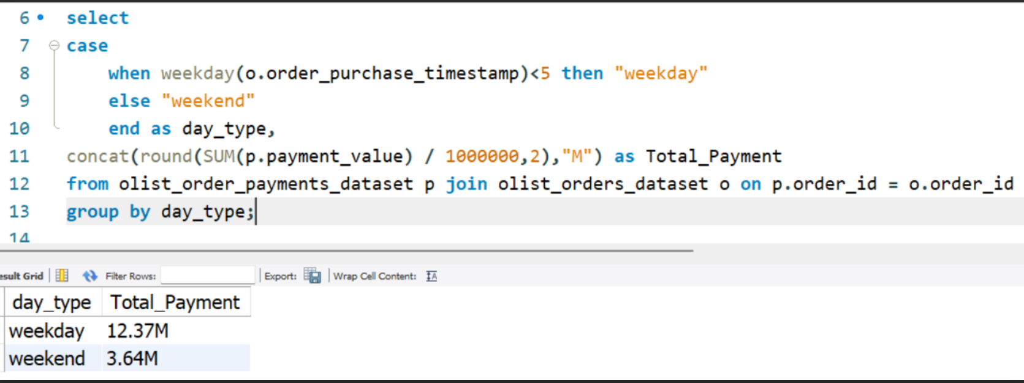

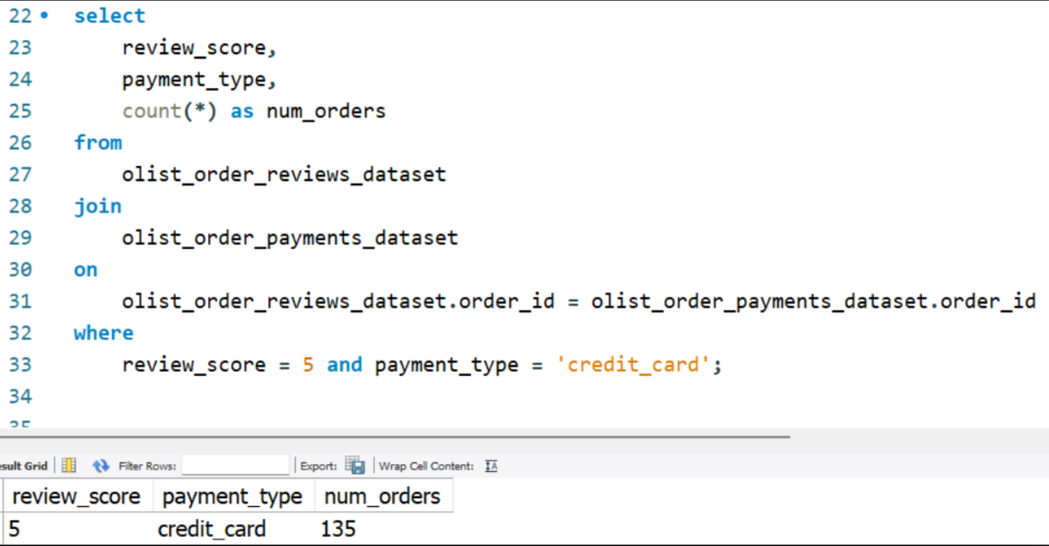
KPI 5 : Relationship between shipping days (order_delivered_customer_date - order_purchase_timestamp) Vs review scores
KPI 2 : Number of Orders with review score 5 and payment type as credit card
KPI 3 : Average number of days taken for order_delivered_customer_date for pet_shop.
KPI 4 : Average price and payment values from customers of Sao Paulo city
KPI 1- Weekday Vs Weekend Payment Statistics
INSIGHTS: Weekdays have more orders than weekends, so businesses should staff up and offer special promotions during the week
KPI 2- Number of Orders with review score 5 and payment type as credit card.
INSIGHTS: São Paulo customers spend money on online orders, so businesses should offer a wider selection of products and services with attractive discounts
Question: How does the length of shipping time correlate with customer review scores, and what improvements in the shipping process can most effectively decrease shipping days and enhance overall customer satisfaction?
Insight: Customers give higher review scores for faster shipping, so businesses should focus on improving their shipping times

Slide 15
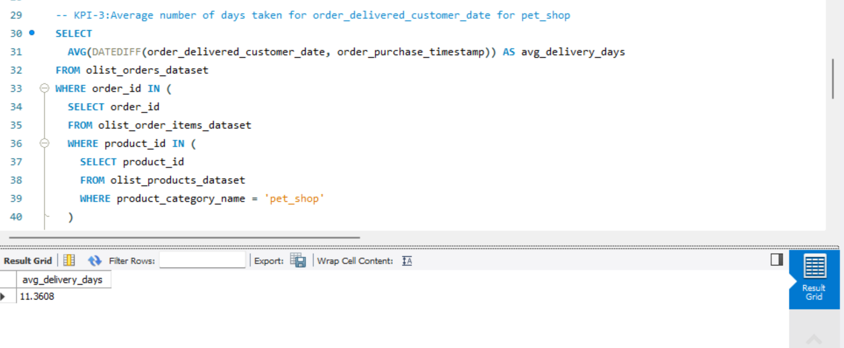
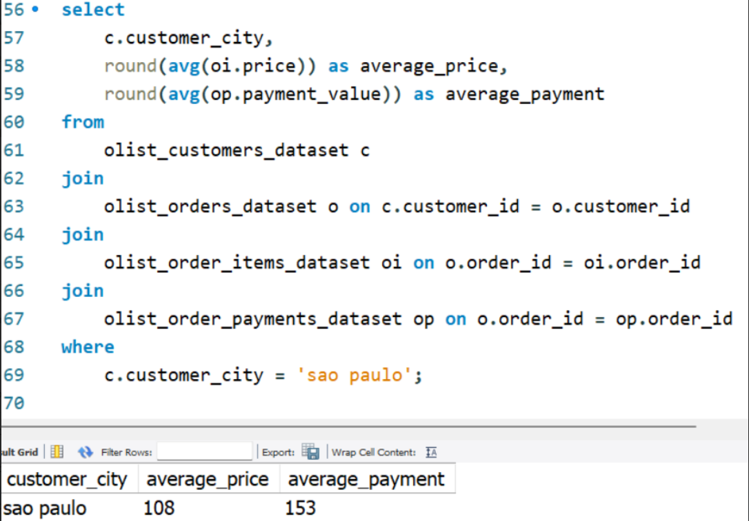
KPI 3 : Average number of days taken for order_delivered_customer_date for pet_shop.
KPI 3 - Average number of days taken for order_delivered_customer_date for pet_shop
INSIGHTS: Pet shop orders take longer days to deliver, so businesses should set realistic delivery expectations and partner with faster shipping carriers
KPI 4 - Average price and payment values from customers of sao paulo city
INSIGHTS: São Paulo customers spend money on online orders, so businesses should offer a wider selection of products and services with attractive discounts
Question: How does the length of shipping time correlate with customer review scores, and what improvements in the shipping process can most effectively decrease shipping days and enhance overall customer satisfaction?
Insight: Customers give higher review scores for faster shipping, so businesses should focus on improving their shipping times

Slide 16
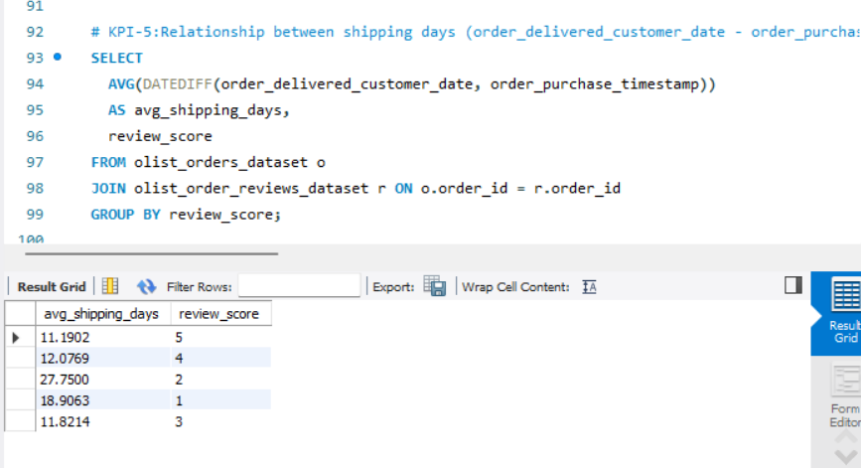
KPI 3 : Average number of days taken for order_delivered_customer_date for pet_shop.
KPI 3 - Average number of days taken for order_delivered_customer_date for pet_shop
INSIGHTS: Pet shop orders take longer days to deliver, so businesses should set realistic delivery expectations and partner with faster shipping carriers
KPI 4 - Average price and payment values from customers of sao paulo city
KPI 5 - Relationship between shipping days (order_delivered_customer_date - order_purchase_timestamp) Vs review scores.
INSIGHT :Customers give higher review scores for faster shipping, so businesses should focus on improving their shipping times
INSIGHTS: São Paulo customers spend money on online orders, so businesses should offer a wider selection of products and services with attractive discounts
Question: How does the length of shipping time correlate with customer review scores, and what improvements in the shipping process can most effectively decrease shipping days and enhance overall customer satisfaction?
Insight: Customers give higher review scores for faster shipping, so businesses should focus on improving their shipping times

Slide 17
KPI 3 : Average number of days taken for order_delivered_customer_date for pet_shop.
KPI 3 - Average number of days taken for order_delivered_customer_date for pet_shop
CONCLUSION
Total order = 99442
Total revenue = 16.01M
Total number of seller =3095
Total number of product = 71
TOP 5 purchased product
health_beauty
bed_bath_table
sports_leisure
computers_accessories
watches_gifts
INSIGHTS: Pet shop orders take longer days to deliver, so businesses should set realistic delivery expectations and partner with faster shipping carriers
KPI 4 - Average price and payment values from customers of sao paulo city
INSIGHTS: São Paulo customers spend money on online orders, so businesses should offer a wider selection of products and services with attractive discounts
INSIGHT :Customers give higher review scores for faster shipping, so businesses should focus on improving their shipping times
KPI 5 - Relationship between shipping days (order_delivered_customer_date - order_purchase_timestamp) Vs review scores.
Question: How does the length of shipping time correlate with customer review scores, and what improvements in the shipping process can most effectively decrease shipping days and enhance overall customer satisfaction?
Insight: Customers give higher review scores for faster shipping, so businesses should focus on improving their shipping times

Slide 18


